Slide 1
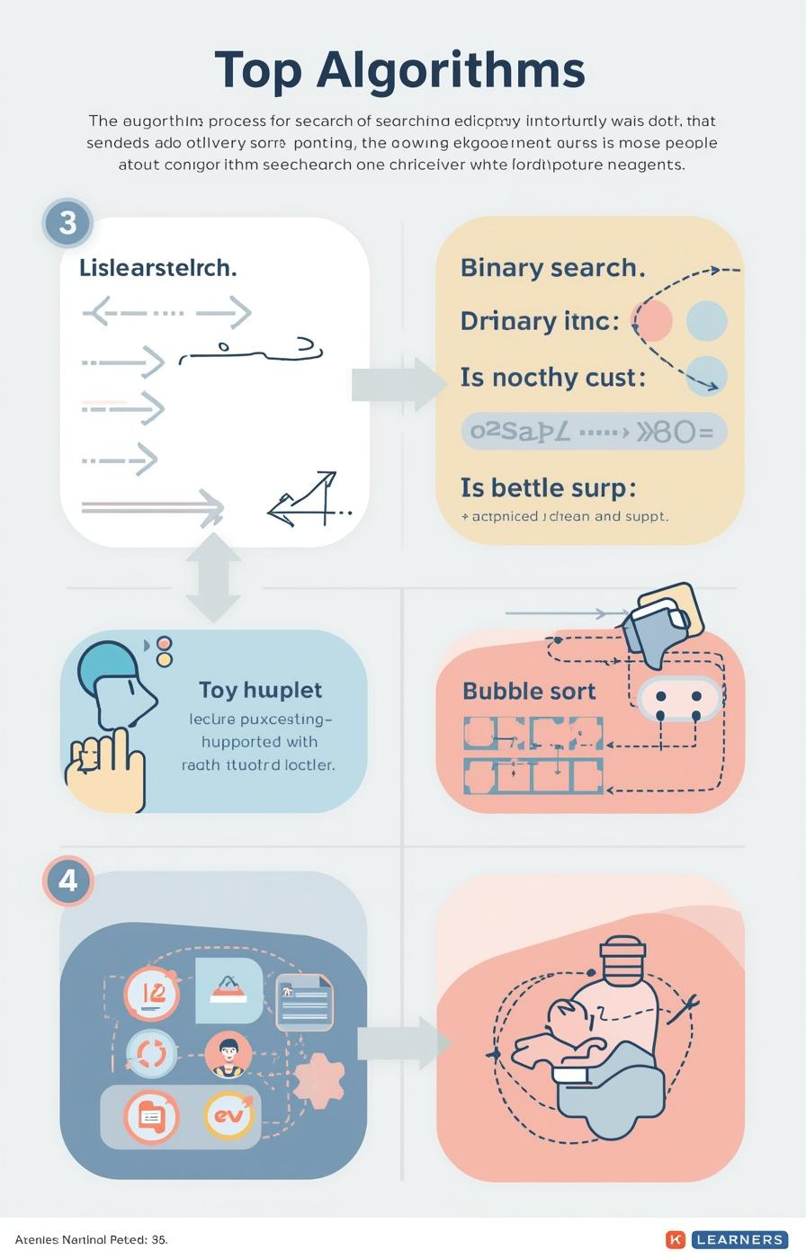

Algorithms: Searching and Sorting
by Mr. Edward Paul

Slide 2

Understanding Algorithms
Their Importance in Computer Science
Algorithms are essential, defined as step-by-step procedures for solving problems. They enable computers to efficiently process information, making them a fundamental aspect of computer science and programming.
2

Slide 3

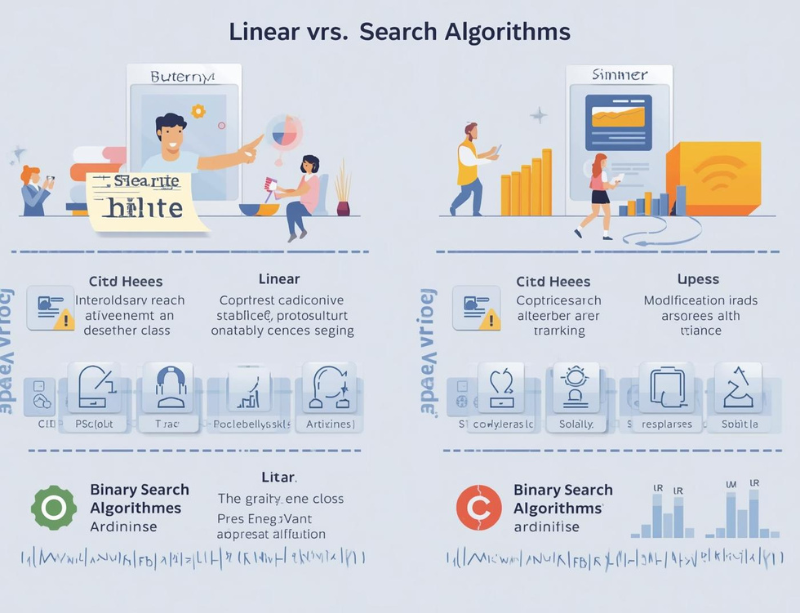
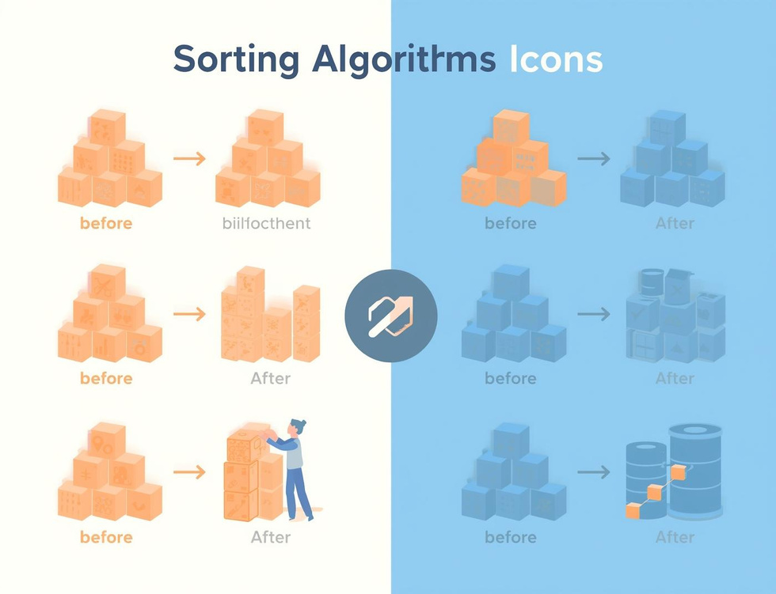
Learning Objectives
Search Algorithms
Compare Efficiencies
Bubble Sort
Understand how algorithms locate data effectively through different searching techniques.
Learn the efficiency differences between linear and binary search methods in data retrieval.
Understand the basics of bubble sort and how it organizes data through comparisons.

Slide 4
Linear Search
Sequential Scanning for Data Retrieval
Definition
Simple Mechanism
Use Cases
Linear search is a straightforward algorithm that checks each element in a list sequentially until it finds the target value or reaches the end of the list.
This method is easy to implement but can be inefficient for large datasets, as it might require examining every single item before locating the desired information.
Linear search is particularly useful for small or unsorted datasets where quick implementation is necessary, making it an ideal choice for simple search tasks.
4

Slide 5
Binary Search
Divide and Conquer Method Explained
Definition
Mechanism
Requirements
Binary search is a fast search algorithm that finds the position of a target value within a sorted array, using a divide-and-conquer strategy for efficiency.
The algorithm repeatedly divides the search interval in half; comparing the target value to the middle element, it narrows down the potential location until the target is found.
For binary search to work, the data must be sorted beforehand; this prerequisite allows the algorithm to efficiently eliminate half of the remaining elements with each comparison.
5

Slide 6

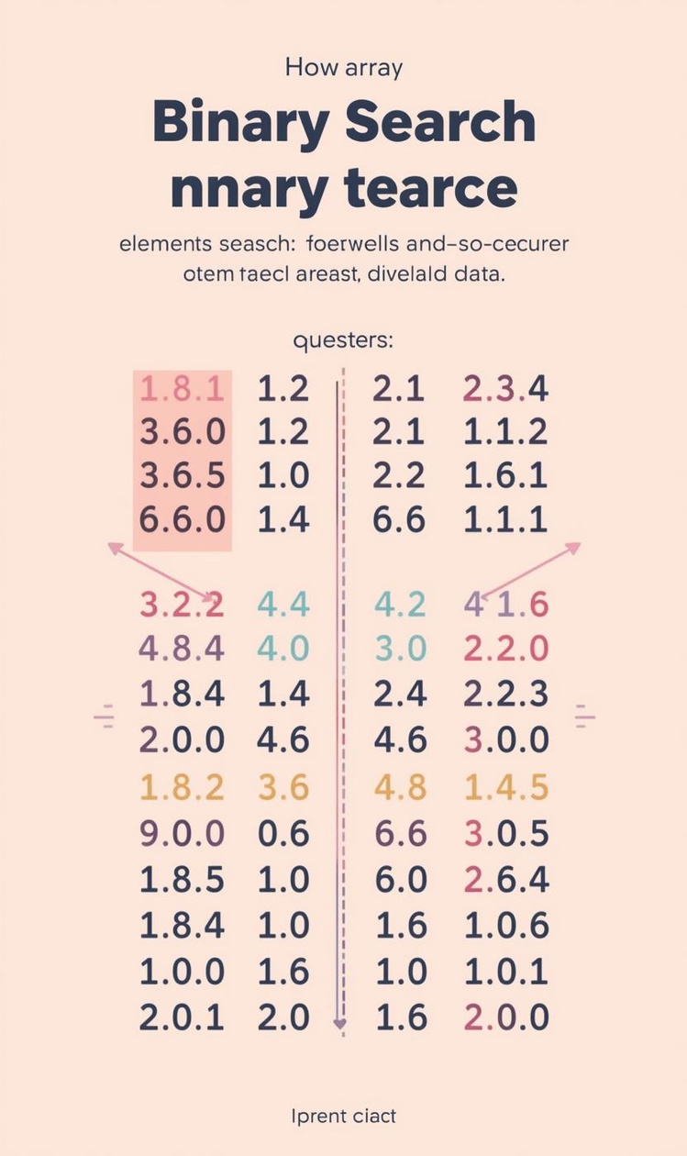

Comparing Efficiency of Search Algorithms
Efficiency
Pros and Cons
Linear search has O(n) time complexity.
Binary search is faster but needs sorted data.

Slide 7
Algorithm Tracing
Linear Search
Binary Search
Efficiency Comparison
In linear search, each element is examined sequentially until the target is found. This straightforward approach is effective for small or unsorted datasets, but can be slow for larger lists.
Binary search requires a sorted list, dividing the search space in half repeatedly, which drastically reduces the number of checks needed to find the target value, making it more efficient than linear search.
Comparing the two searches, linear search has a time complexity of O(n), while binary search operates at O(log n), highlighting the significant efficiency gained through the divide-and-conquer strategy of binary search.

Slide 8
Bubble Sort
Introducing Sorting Algorithms and Their Importance
8

Slide 9
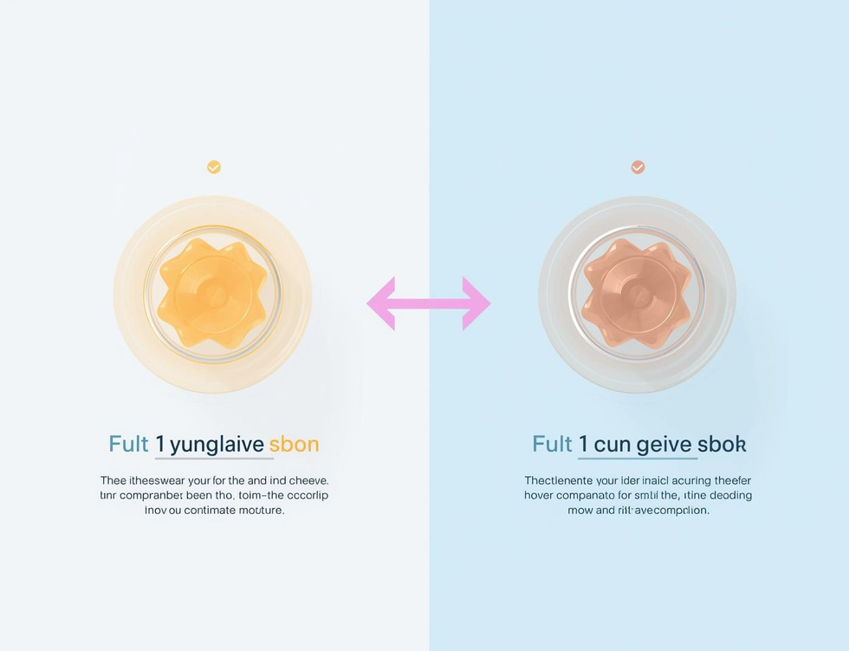

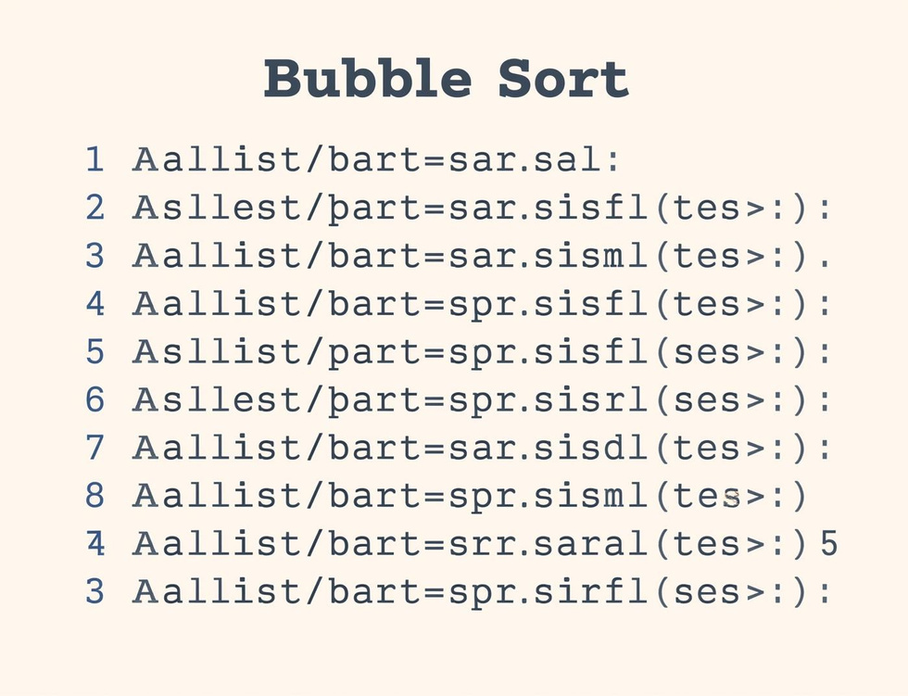
Bubble Sort Steps
Compare Elements
Swap if Needed
Repeat Passes
Compare adjacent elements to determine if they need swapping for sorting.
Elements are swapped if they are in the wrong order, ensuring sorting progress.
The sorting process continues with repeated passes until the entire list is sorted.

Slide 10

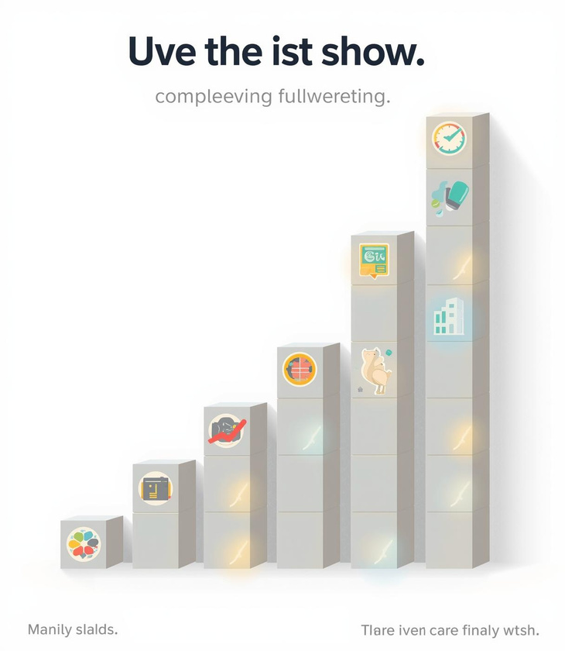
Tracing Bubble Sort Steps

Slide 11
Key Takeaways and Insights
01
Search Algorithms
Linear and binary searches each have distinct strengths.
02
Sorting Concepts
Bubble sort is an essential foundational sorting algorithm.
03
Tracing Importance
Understanding algorithms requires step-by-step tracing practice.

Slide 12

Continue Learning
Practice tracing algorithms today!

Slide 13
Lesson on Algorithm - Year 3
AI-Generated Teaching Slides

Slide 14
This lesson pack is designed for Year 3 (ages 7-8) to introduce the concept of a
---
## Lesson Pack: Algorithms - Year 3
**Topic:** Introduction to Algorithms
**Target Age:** Year 3 (7-8 years old)
**Duration:** 60 minutes (flexible, can be extended with activity time)
---
### 1. Lesson Objectives
By the end of this lesson, pupils will be able to:
* **I can explain** what an algorithm is using my own words.
* **I can identify** simple algorithms in everyday activities.
* **I can follow** a set of instructions (an algorithm) carefully.
* **I can create** a simple set of step-by-step instructions (an algorithm) for a task.
* **I can understand** why the order of steps is important in an algorithm.
---
### 2. Introduction / Starter Activity
**Activity Title:** The Jam Sandwich Challenge!
**Time:** 10-15 minutes
**Materials:** Bread, jam, butter (optional), a butter knife, a plate, a whiteboard/flipchart.
**Instructions:**

Slide 15
**Engage:** "Good morning, Year 3! Today we're going to learn about something su

Slide 16
**Demonstrate (Incorrectly):** Bring out the materials. "I want to make a delici

Slide 17
**Follow Literally (and deliberately poorly):** As pupils give instructions, fol
* If they say: "Put jam on the bread." (Pick up the jar of jam and try to put the whole jar on the bread, or put it on the table *next* to the bread).
* If they say: "Cut the bread." (Try to cut the bread *before* putting anything on it, or with the jam knife, or cut a random part of the bread).
* If they say: "Get two slices of bread." (This is a good start!).

Slide 18
**Discuss:** "Oh dear! My sandwich isn't looking very tasty, is it? Why do you t

Slide 19
**Re-do (Correctly):** "What if we try again, but this time, you give me *very c

Slide 20
**Introduce Vocabulary:** "Fantastic! You just created a brilliant set of instru
---
### 3. Key Teaching Points
**Time:** 10-15 minutes
**Delivery:** Use the PowerPoint slides (see Section 7) to guide this section.
* **What is an Algorithm?**
* Explain simply: "An algorithm is a set of clear, step-by-step instructions that tell you how to complete a task or solve a problem."
* Use the analogy of a "recipe" – a recipe is an algorithm for cooking!
* Key idea: You follow the steps one by one, in the right order.
* **Why are Algorithms Important?**
* They help us make sure we get the right result every time.
* They make sure nothing is missed.
* They make things clear and easy to understand.
* Emphasise the importance of **ORDER** – if steps are in the wrong order, the algorithm won't work (like our first jam sandwich!).
* **Algorithms in Everyday Life:**
* **Morning Routine:** (Getting dressed, brushing teeth, eating breakfast). Ask pupils to list steps.
* **Making a drink:** (e.g., hot chocolate, glass of juice).
* **Playing a game:** (Instructions for a board game or a simple playground game).
* **Tidying your room:** (Pick up toys, put clothes away, make bed).
* *Quick check:* Ask pupils for another example of an algorithm they use every day.
* **Algorithms and Computers:**
* "Computers and robots are very clever, but they can't think for themselves. They need algorithms!"
* "When you play a game on a tablet or computer, or when a robot tidies up, someone wrote an algorithm (like a super-long list of instructions) to tell it exactly what to do."
* "It's like you were the 'programmer' for the jam sandwich algorithm!" (Keep this brief and light).
* **Key Features of a Good Algorithm:**
* **Clear steps:** Easy to understand.
* **Correct order:** Steps must be in the right sequence.
* **Leads to a goal:** It helps you finish the task.
---
### 4. Guided Practice or Activities
**Time:** 20-25 minutes
**Materials:** Activity sheets, scissors, glue, coloured pens/pencils, space to move.
**Activity 1: "Order Up!" (Individual / Pair Work)**
* **Concept:** Understanding sequence and correcting errors.
* **Instructions:**
1. Provide each pupil (or pair) with a worksheet containing jumbled step-by-step instructions for a familiar task (e.g., "How to Brush Your Teeth," "How to Plant a Seed," "How to Make a Paper Aeroplane").
2. The steps should be printed on separate strips of paper for cutting, or numbered in a jumbled order for pupils to re-write.
3. Pupils cut out the steps (if applicable) and arrange them in the correct logical order, then glue them onto a separate sheet or write them down.
4. **Differentiation:** For support, provide fewer steps or use pictures. For challenge, include a 'trick' step that doesn't belong.
* **Teacher Role:** Circulate, offer support, ask questions like "What would happen if you did that step first?"
**Activity 2: "Robot Teacher" (Pair / Small Group - Movement)**
* **Concept:** Creating precise algorithms, following instructions, debugging.
* **Instructions:**
1. Divide the class into pairs or small groups.
2. One child is the "Robot," the other is the "Programmer" (or "Teacher").
3. The Programmer chooses a simple task for the Robot to complete within the classroom space (e.g., "Robot, go to the whiteboard and pick up the blue pen," "Robot, walk to the reading corner and sit down").
4. The Programmer must give the Robot a clear, step-by-step algorithm using precise instructions (e.g., "Take two steps forward," "Turn right," "Take one step forward," "Bend down," "Pick up the pen," "Stand up").
5. The Robot must follow the instructions *literally* – if the instruction isn't clear enough, the robot does it wrong or gets "stuck."
6. The Programmer then "debugs" their algorithm (finds the errors) and corrects their instructions to make the robot complete the task successfully.
7. Swap roles after a few minutes.
* **Teacher Role:** Observe, encourage clear communication, prompt "programmers" to be more specific, highlight "debugging" as finding and fixing errors in the algorithm.
**Activity 3: "My Super Algorithm!" (Individual - Creative)**
* **Concept:** Applying understanding to create own algorithms.
* **Instructions:**
1. Provide a worksheet with a blank space or numbered lines.
2. "Now it's your turn to be the algorithm expert! Think of a simple task you do or know how to do really well. For example: 'How to Feed My Pet', 'How to Make a Cup of Tea (for an adult!)', 'How to Draw a Stick Person', 'How to Play a Simple Game'."
3. Pupils write (or draw if preferred) their step-by-step algorithm for their chosen task. Encourage them to number their steps.
* **Teacher Role:** Help pupils choose appropriate tasks, remind them about clear steps and correct order, check for understanding.
---
### 5. Assessment Ideas
**Informal (Ongoing during activities):**
* **Observation:** During "Robot Teacher," observe if pupils can give clear, precise instructions and if they can "debug" their algorithms. During "Order Up!," observe how pupils sequence the instructions and if they grasp the concept of order.
* **Questioning:** Ask pupils to explain their reasoning for placing steps in a particular order. "Why is step 3 important before step 4?" "What would happen if we swapped these two steps?"
* **Participation:** Are pupils engaged and contributing to discussions about algorithms?
**Formal (Product-based):**
* **"My Super Algorithm!" Worksheet:** Collect and review these. Look for:
* **Clarity:** Are the instructions easy to understand?
* **Correct Order:** Are the steps in a logical sequence that would achieve the goal?
* **Completeness:** Are all necessary steps included?
* This provides a direct link to the objective "I can create a simple set of step-by-step instructions."
---
### 6. Summary / Conclusion
**Time:** 5 minutes

Slide 21
**Recap:** "Wow, we've done a lot of amazing learning today! Who can tell me, in

Slide 22
**Examples:** "Can you give me an example of an algorithm you use every day, or

Slide 23
**Importance of Order:** "Why is it so important that the steps in an algorithm

Slide 24
**Future Link:** "You've all been amazing algorithm creators and followers today

Slide 25
**Positive Reinforcement:** Praise effort and understanding.
---
### 7. PowerPoint Slide Outline
**Slide 1: Title Slide**
* **Title:** Algorithms: Step-by-Step Superstars!
* **Subtitle:** Year 3 Computing
* **Image:** Fun, friendly robot or animated character giving instructions.
**Slide 2: Learning Objectives**
* **Title:** Our Learning Adventure Today!
* **Bullet Points:**
* I can explain what an algorithm is.
* I can find algorithms in everyday life.
* I can follow instructions carefully.
* I can make my own step-by-step instructions.
* I can understand why the order of steps matters.
* **Image:** A checklist or a roadmap.
**Slide 3: Starter Activity: The Jam Sandwich Challenge!**
* **Title:** Can You Make a Jam Sandwich?
* **Bullet Points:**
* Listen carefully to my instructions.
* I will follow exactly what you say!
* Let's see if we can make a delicious sandwich together.
* **Image:** Ingredients for a jam sandwich.
**Slide 4: What Went Wrong? (Or Right!)**
* **Title:** Oops! Or Yum! What Happened?
* **Bullet Points:**
* Why did my first sandwich not work?
* What did we need to make it better?
* *Hint:* Clear steps and correct order!
* **Image:** A messy, badly made sandwich next to a perfectly made one.
**Slide 5: What is an Algorithm?**
* **Title:** Introducing the Algorithm!
* **Bullet Points:**
* An **Algorithm** is a set of clear, step-by-step instructions.
* It tells you how to complete a task or solve a problem.
* Think of it like a **recipe**!
* **Image:** A recipe book, or a sequence of simple steps (e.g., wash hands -> dry hands).
**Slide 6: Algorithms Everywhere!**
* **Title:** Algorithms in Our Daily Life
* **Bullet Points:**
* Getting ready in the morning.
* Making a cup of juice.
* Tidying your room.
* Playing a game.
* What other algorithms do you use?
* **Image:** Collage of daily activities (brushing teeth, pouring juice, dressing).
**Slide 7: Why Does Order Matter?**
* **Title:** The Super Power of Order!
* **Bullet Points:**
* If steps are in the wrong order, the algorithm won't work!
* (Show a simple example: put on socks, *then* put on shoes. What if we put shoes on first?)
* Every step must be in the right place.
* **Image:** Two sequences for getting dressed, one correct, one clearly jumbled.
**Slide 8: Activity 1: Order Up!**
* **Title:** Let's Get Our Steps in Order!
* **Bullet Points:**
* You have a jumbled set of instructions.
* Cut them out (or write them).
* Put them in the correct step-by-step order.
* What is your algorithm for...?
* **Image:** Scissors and glue icon, or a question mark over jumbled items.
**Slide 9: Activity 2: Robot Teacher**
* **Title:** You Are the Robot! You Are the Programmer!
* **Bullet Points:**
* Work in pairs or small groups.
* One person is the "Programmer" (gives instructions).
* One person is the "Robot" (follows *exactly*).
* Give clear, step-by-step instructions for a simple task.
* If the robot gets stuck, "debug" (fix) your algorithm!
* **Image:** Simple robot illustration, speech bubbles for instructions.
**Slide 10: Activity 3: My Super Algorithm!**
* **Title:** Create Your Own Algorithm!
* **Bullet Points:**
* Choose a simple task you know well (e.g., how to draw a simple shape, how to feed a pet, how to make a paper airplane).
* Write or draw your clear, step-by-step instructions.
* Make sure your steps are in the correct order!
* **Image:** A blank notebook and pencil, or a "thinking bubble" over a child.
**Slide 11: What Did We Learn?**
* **Title:** Algorithm Champions!
* **Bullet Points:**
* An algorithm is... (ask class for definition).
* We see algorithms every day when we... (ask for examples).
* The most important thing about an algorithm is the... (ask for 'order').
* Computers need algorithms to... (ask for 'know what to do').
* **Image:** Checkmarks, stars, or a "lightbulb" moment.
**Slide 12: Conclusion**
* **Title:** Keep Exploring Algorithms!
* **Bullet Points:**
* You are all amazing algorithm creators and followers!
* This is a fantastic skill for future coding and problem-solving.
* Look for algorithms everywhere you go!
* **Image:** A child using a tablet to code, or a friendly robot waving goodbye.
---

